Slide 1
Keypoint-based Recognition and Object Search
03/08/11
Computer Vision
CS 543 / ECE 549
University of Illinois
Derek Hoiem

Slide 2
Notices
I’m having trouble connecting to the web server, so can’t post lecture slides right now
HW 2 due Thurs
Guest lecture Thurs by Ali Farhadi

Slide 3
General Process of Object Recognition
Specify Object Model
Generate Hypotheses
Score Hypotheses
Resolution

Slide 4


General Process of Object Recognition
Example: Keypoint-based Instance Recognition
Specify Object Model
A₁
B₃
A₃
A₂
B₁
B₂
Generate Hypotheses
Last Class
Score Hypotheses
Resolution

Slide 5


Overview of Keypoint Matching
1. Find a set of distinctive key- points
A₁
B₃
2. Define a region around each keypoint
A₂
A₃
B₁
B₂
3. Extract and normalize the region content
4. Compute a local descriptor from the normalized region
N pixels
e.g. color
e.g. color
N pixels
5. Match local descriptors

Slide 6
General Process of Object Recognition
Example: Keypoint-based Instance Recognition
Specify Object Model
A₁
B₃
A₃
A₂
Affine-variant point locations
B₁
B₂
Generate Hypotheses
Affine Parameters
Score Hypotheses
This Class
# Inliers
Resolution
Choose hypothesis with max score above threshold

Slide 7
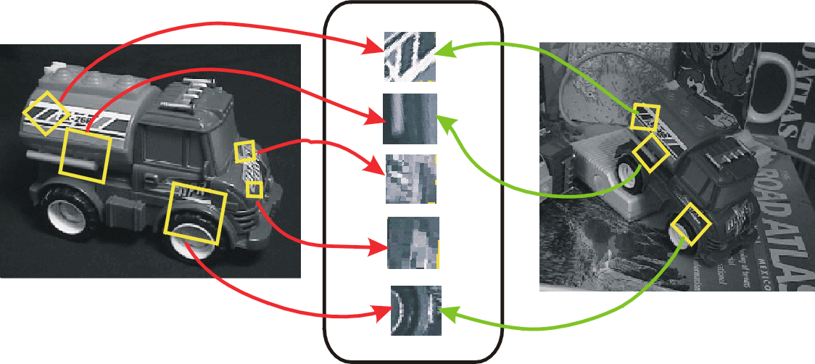
Keypoint-based instance recognition
Given two images and their keypoints (position, scale, orientation, descriptor)
Goal: Verify if they belong to a consistent configuration
Local Features, e.g. SIFT
Slide credit: David Lowe

Slide 8
Finding the objects (overview)
Input Image
Stored Image
Match interest points from input image to database image
Matched points vote for rough position/orientation/scale of object
Find triplets of position/orientation/scale that have at least three votes
Compute affine registration and matches using iterative least squares with outlier check
Report object if there are at least T matched points

Slide 9
Matching Keypoints
Want to match keypoints between:
Query image
Stored image containing the object
Given descriptor x₀, find two nearest neighbors x₁, x₂ with distances d₁, d₂
x₁ matches x₀ if d₁/d₂ < 0.8
This gets rid of 90% false matches, 5% of true matches in Lowe’s study

Slide 10
Affine Object Model
Accounts for 3D rotation of a surface under orthographic projection

Slide 11
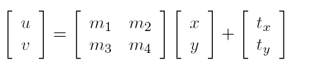
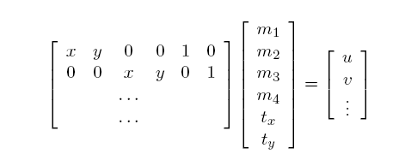
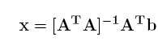
Affine Object Model
Accounts for 3D rotation of a surface under orthographic projection
Scaling/skew
Translation
What is the minimum number of matched points that we need?

Slide 12
Finding the objects (in detail)
Match interest points from input image to database image
Get location/scale/orientation using Hough voting
In training, each point has known position/scale/orientation wrt whole object
Matched points vote for the position, scale, and orientation of the entire object
Bins for x, y, scale, orientation
Wide bins (0.25 object length in position, 2x scale, 30 degrees orientation)
Vote for two closest bin centers in each direction (16 votes total)
Geometric verification
For each bin with at least 3 keypoints
Iterate between least squares fit and checking for inliers and outliers
Report object if > T inliers (T is typically 3, can be computed to match some probabilistic threshold)

Slide 13
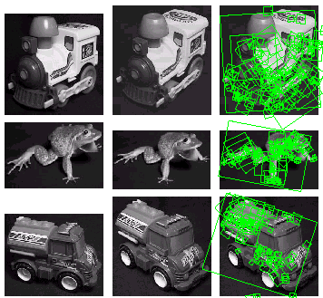
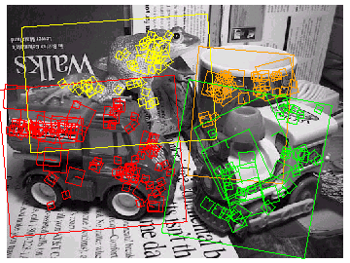
Examples of recognized objects

Slide 14
View interpolation
Training
Given images of different viewpoints
Cluster similar viewpoints using feature matches
Link features in adjacent views
Recognition
Feature matches may be spread over several training viewpoints
⇒ Use the known links to “transfer votes” to other viewpoints
[Lowe01]
Slide credit: David Lowe

Slide 15
Applications
Sony Aibo (Evolution Robotics)
SIFT usage
Recognize docking station
Communicate with visual cards
Other uses
Place recognition
Loop closure in SLAM
Slide credit: David Lowe

Slide 16
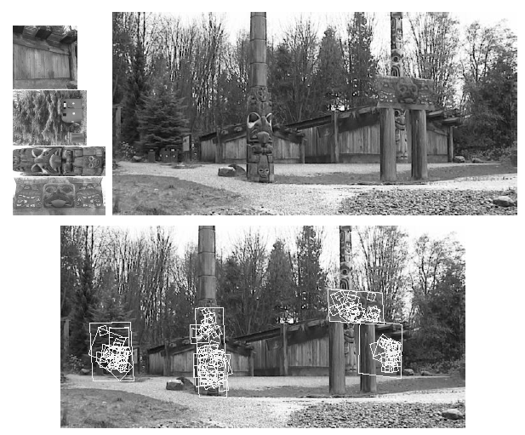
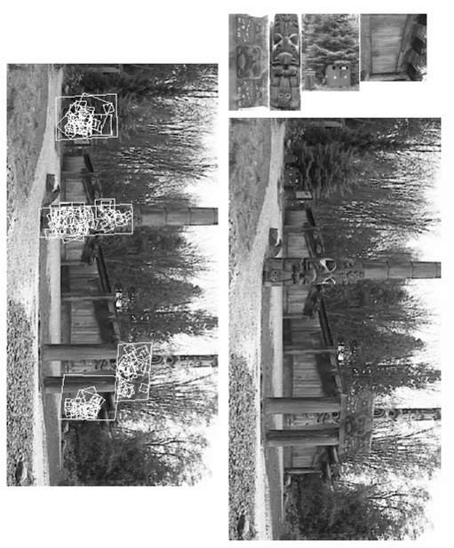
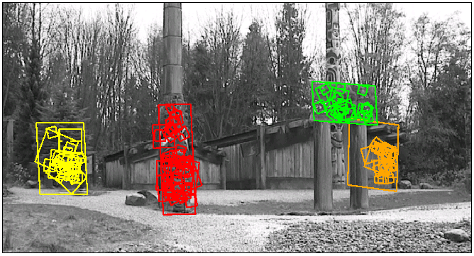
Location Recognition
Training
[Lowe04]
Slide credit: David Lowe

Slide 17
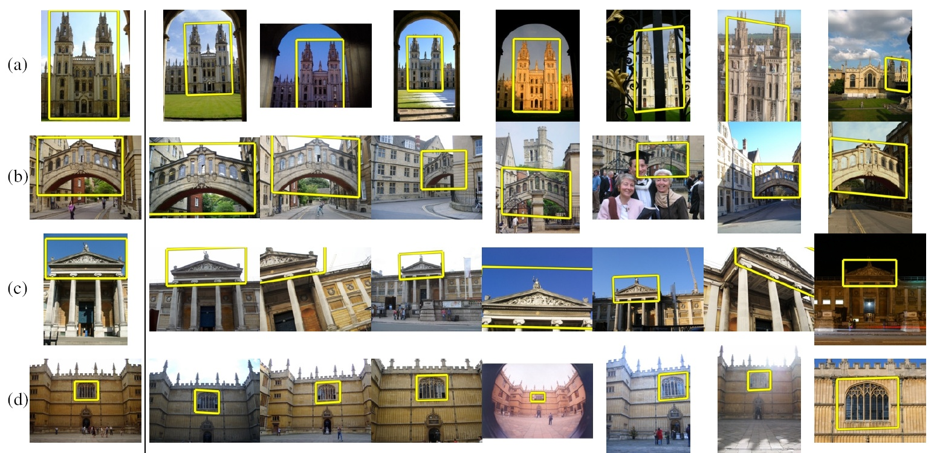
How to quickly find images in a large database that match a given image region?

Slide 18
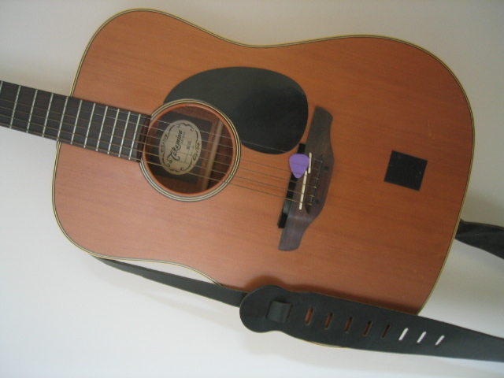
Simple idea
See how many keypoints are close to keypoints in each other image
Lots of Matches
Few or No Matches
But this will be really, really slow!

Slide 19
Fast visual search
“Video Google”, Sivic and Zisserman, ICCV 2003
“Scalable Recognition with a Vocabulary Tree”, Nister and Stewenius, CVPR 2006.

Slide 20
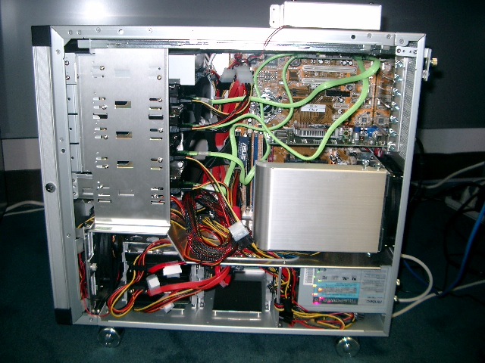
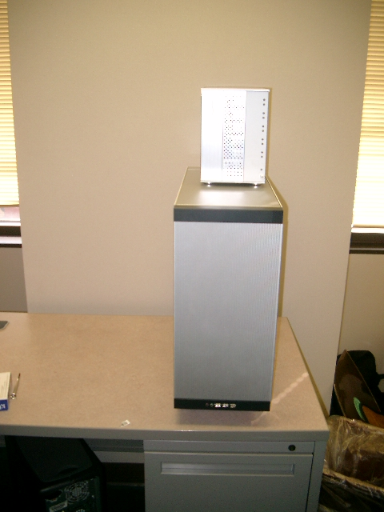
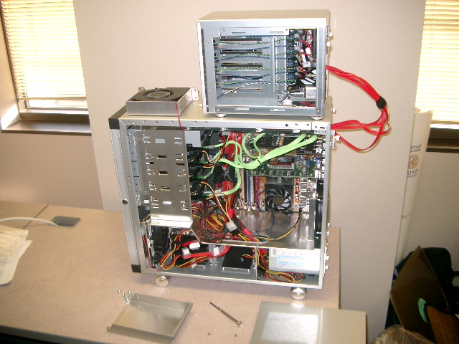
110,000,000 Images in 5.8 Seconds
Slide
Slide Credit: Nister
Notes:
Very recently, we have scaled the system even further.
The system we just demo’d searches a 50 thousand image index in the RAM of this laptop at real-time rates.
We have built and programmed a desktop system at home in which we currently have 12 hard drives. We bypass the operating system and
read and write the disk surfaces directly.
Last week this system clocked in on 110 Million images in 5.8 seconds, so roughly 20Million images per second and machine.
The images consist of around 10 days of four TV channels, so more than a month of TV.
Soon we don’t have to watch TV, because we’ll have machines doing it for us.

Slide 21
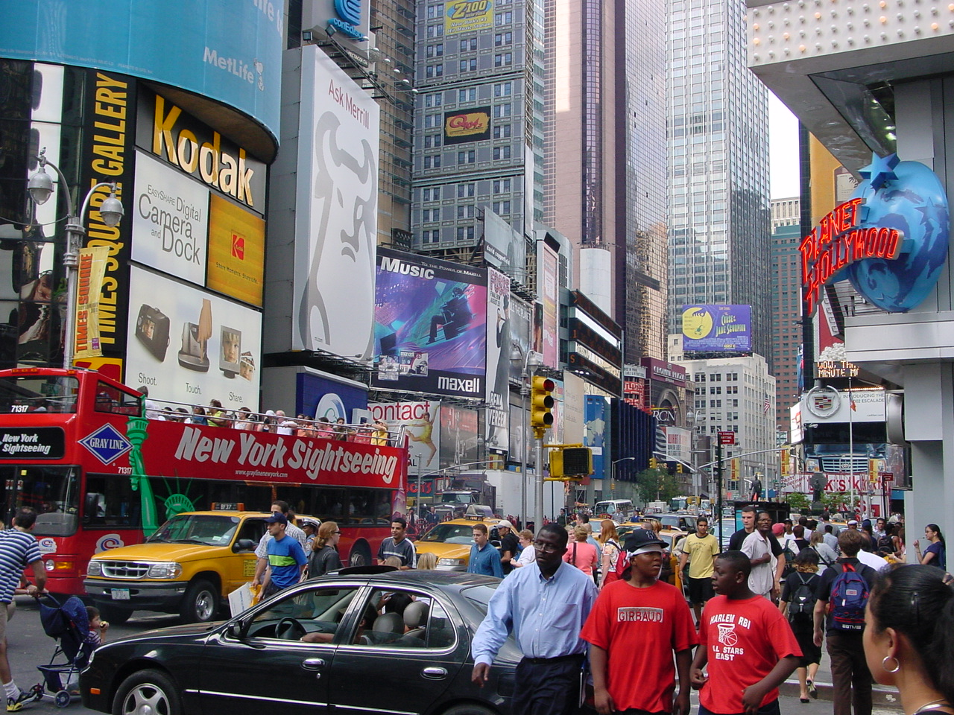


Slide
Slide Credit: Nister
Notes:
To continue the analogy, if we printed all these images on paper, and stacked them,

Slide 22
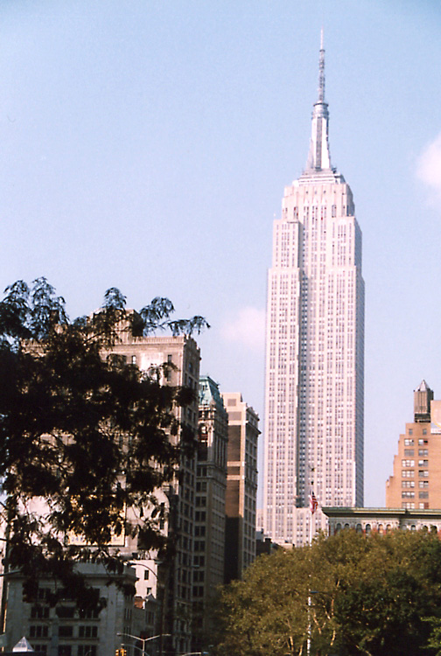
Slide
Slide Credit: Nister
Notes:
The pile would stack, as high as

Slide 23
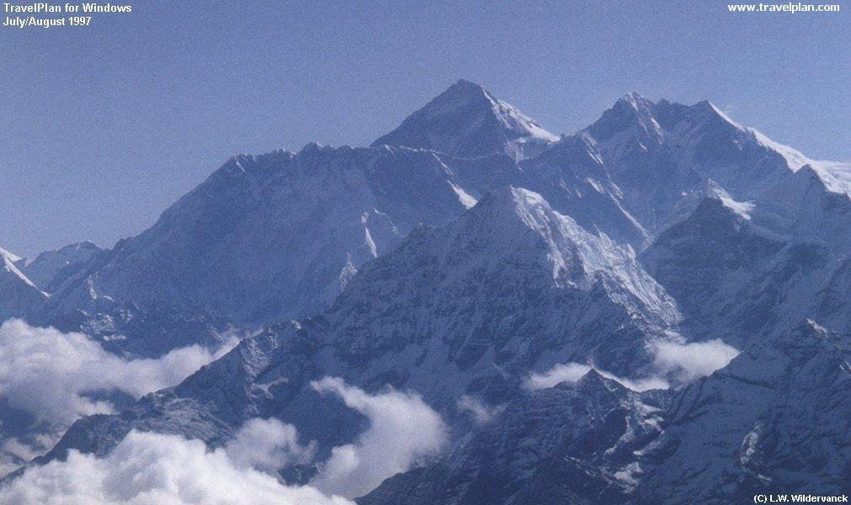
Slide
Slide Credit: Nister
Notes:
Mount Everest.
Another way to put perspective on this is, Google image search not too long ago claimed to index 2 billion images,
although based on meta-data, while we do it based on image content.
So, with about 20 desktop systems like the one I just showed, it seems that it may be possible to build a web-scale content-based image search engine,
and we are sort of hoping that this paper will fuel the race for the first such search engine.
So, that is some motivation.
Let me now move to the contribution of the paper.
As you can guess by now, it is about scalability of recognition and retrieval.

Slide 24
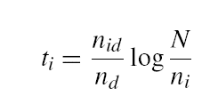
Key Ideas
Visual Words
Cluster descriptors (e.g., K-means)
Inverse document file
Quick lookup of files given keypoints
tf-idf: Term Frequency – Inverse Document Frequency
# documents
# times word appears in document
# documents that contain the word
# words in document

Slide 25
Recognition with K-tree
Following slides by David Nister (CVPR 2006)

Slide 26
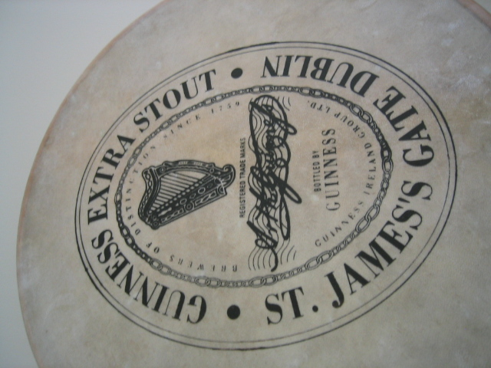
Notes:
I will now try to describe the approach with an animation.
The first, offline phase, is to train the vocabulary tree.
We use Maximally Stable Extremal Regions by Matas et al. and then we extract SIFT descriptors from the MSER regions.
Regarding the feature extraction, we are not really claiming anything other than down-in-the-trenches nose-to-the-grindstone hard work to get good implementations of the state-of-the-art, and since we are all obsessed with novelty I will not spend any time talking about the feature extraction.
We believe that the vocabulary tree approach will work well on any of your favorite descriptors.

Slide 27
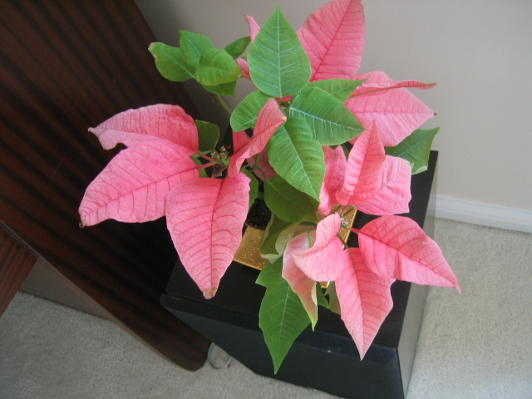
Notes:
All the descriptor vectors are thrown into a common space.
This is done for many images, the goal being to acquire enough statistics on how natural images distribute points in the descriptor space.

Slide 29
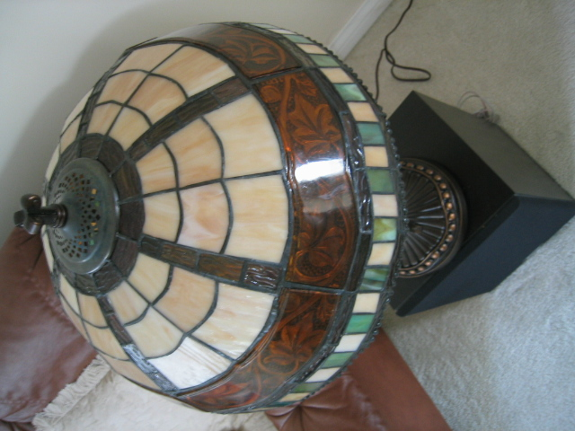

Slide 30


Slide 31


Slide 33
Notes:
We then run k-means on the descriptor space. In this setting, k defines what we call the branch-factor of the tree, which indicates how fast the tree branches.
In this illustration, k is three. We then run k-means again, recursively on each of the resulting quantization cells.
This defines the vocabulary tree, which is essentially a hierarchical set of cluster centers and their corresponding Voronoi regions.
We typically use a branch-factor of 10 and six levels, resulting in a million leaf nodes. We lovingly call this the Mega-Voc.

Slide 43
Notes:
We now have the vocabulary tree, and the online phase can begin.
In order to add an image to the database, we perform feature extraction. Each descriptor vector is now dropped down from the root of the tree and quantized very efficiently into a path down the tree, encoded by a single integer.
Each node in the vocabulary tree has an associated inverted file index.
Indecies back to the new image are then added to the relevant inverted files.
This is a very efficient operation that is carried out whenever we want to add an image.

Slide 44
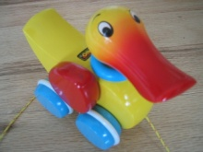


Slide 45
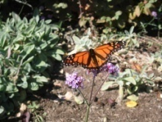


Slide 46



Slide 47



Slide 48
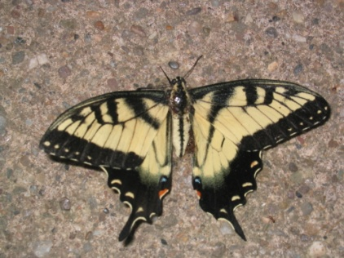
Notes:
When we then wish to query on an input image, we quantize the descriptor vectors of the input image in a similar way, and accumulate scores for the images in the database with so called term frequency inverse document frequency (tf-idf). This is effectively an entropy weighting of the information. The winner is the image in the database with the most common information with the input image.

Slide 49
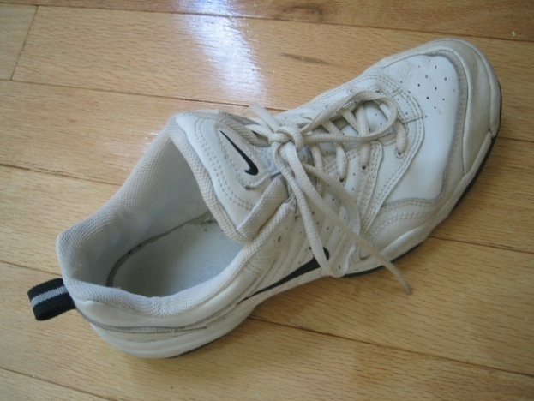
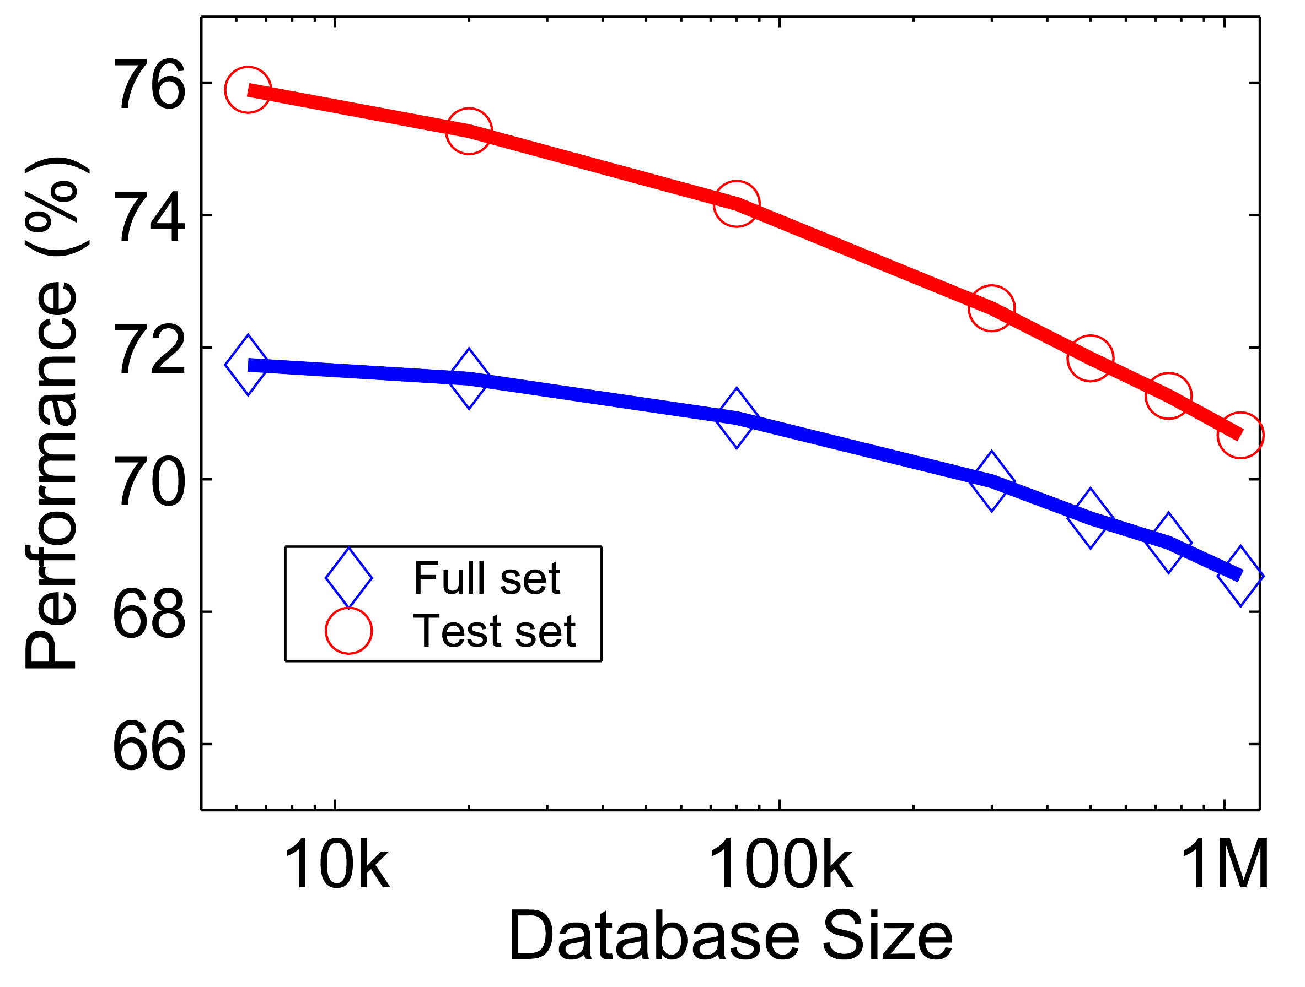








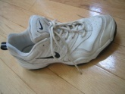
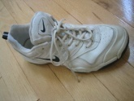
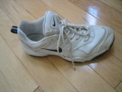
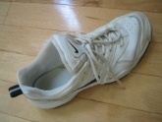
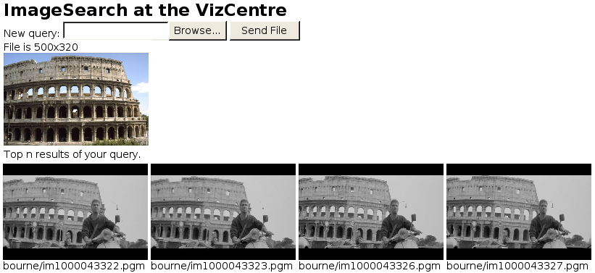





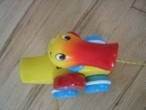
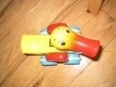
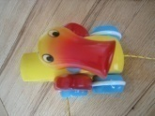




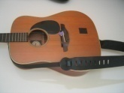

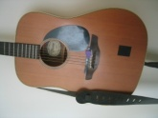
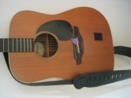
Performance
Notes:
One of the reasons we managed to take the system this far is that we have worked with rigorous performance testing against a database with ground truth.
We now have a benchmark database with over 10000 images grouped in sets of four images of the same object. We query on one of the images in the group and see how many of the other images in the group make it to the top of the query.
In the paper, we have tested this up to a million images, by embedding the ground truth database into a database encompassing all the frames of 10 feature length movies.

Slide 50
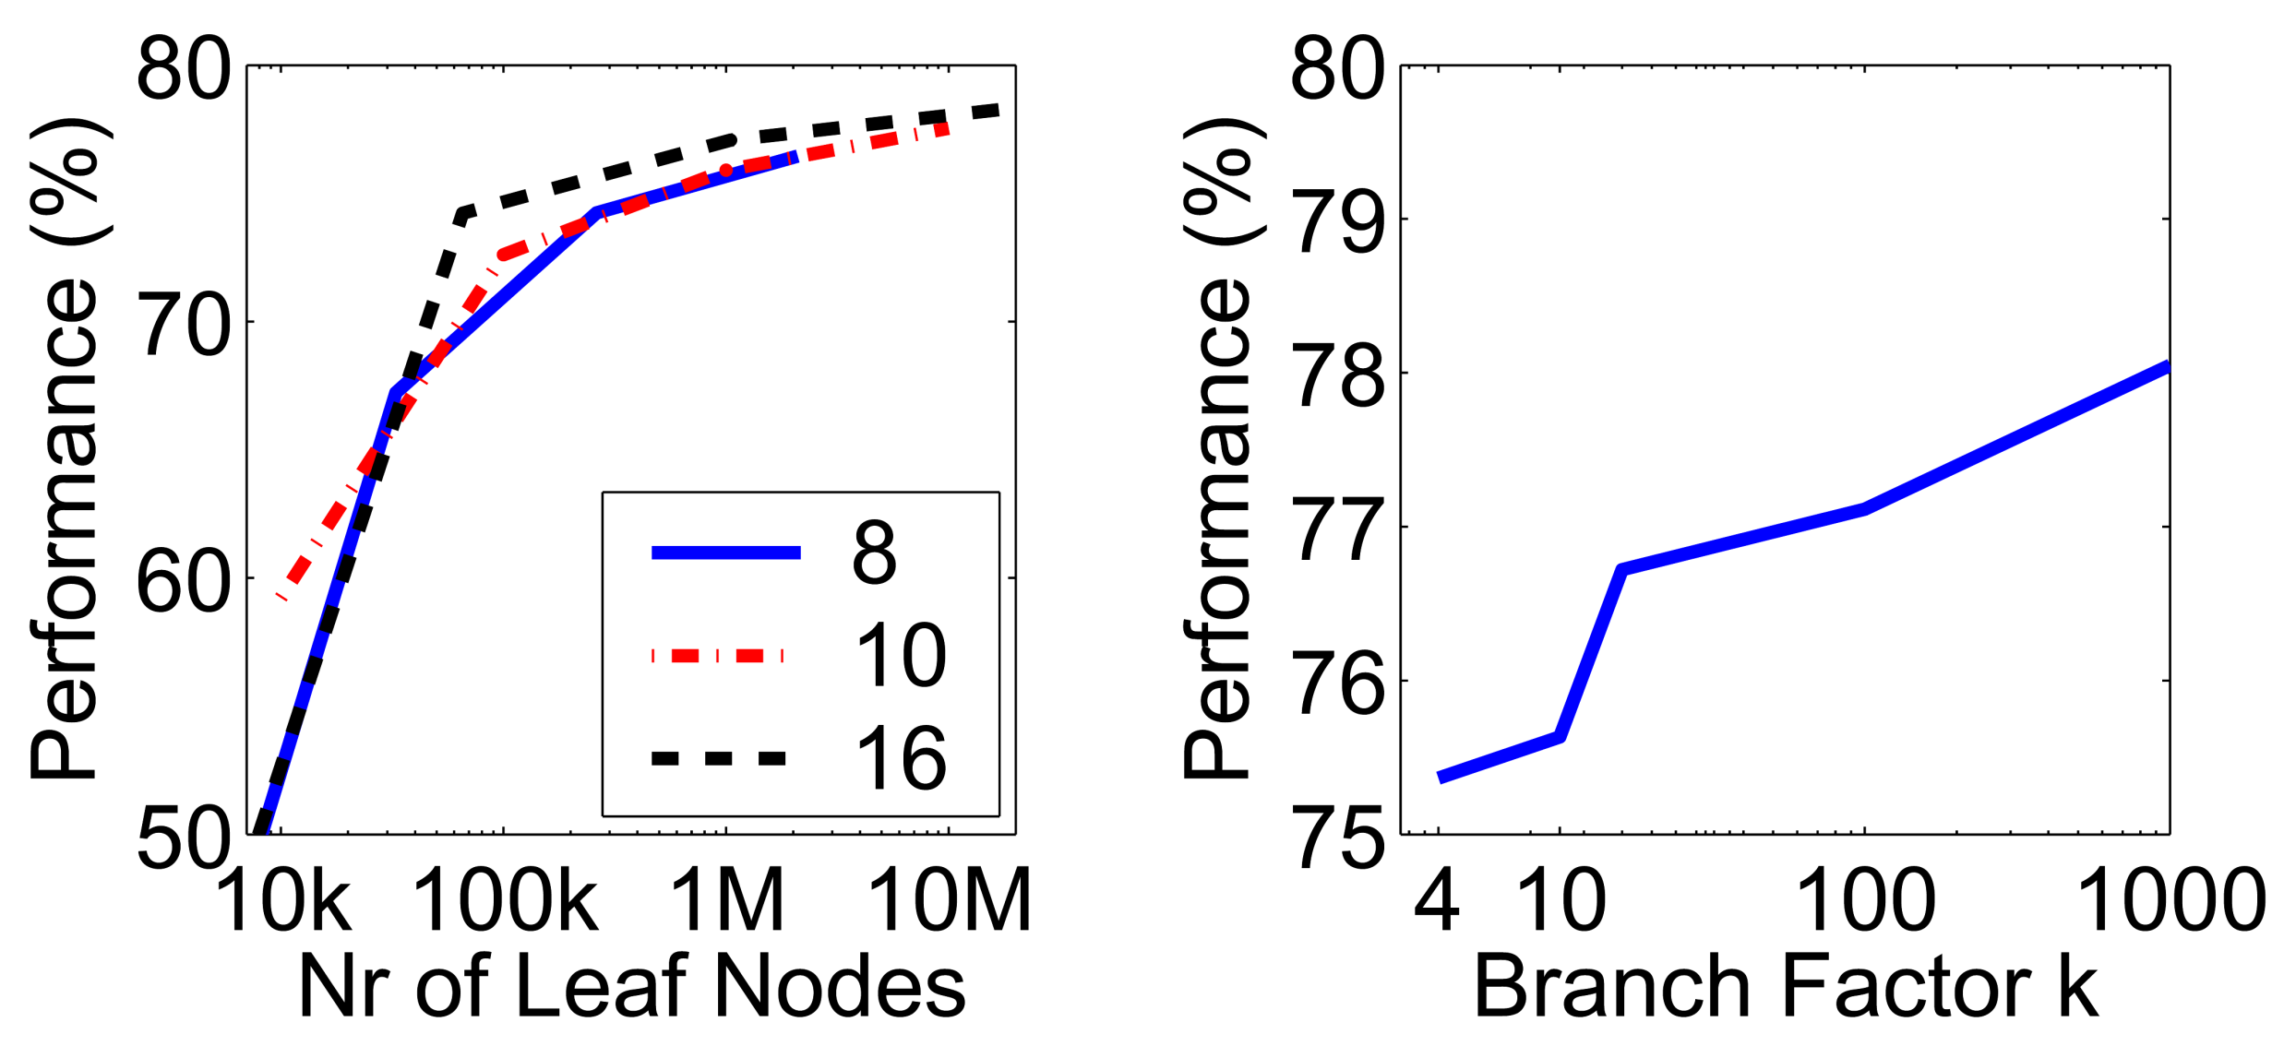
More words is better
Improves
Retrieval
Improves
Speed
Branch factor
Notes:
We have used the performance testing to explore various settings for the algorithm.
The most important finding is that the number of leaf nodes in the vocabulary tree is very important.
In principle, there is a trade-off, because we wish to have discriminative quantizations, which implies many leaf-nodes, while we also wish to have repeatable quantizations, which implies few leaf nodes.
However, it seems that in a large practical range, the bigger the better when it comes to the vocabulary. This probably depends on the descriptors used, but is not entirely surprising, since we are trying to divide up a 128-dimensional space in discriminative bins.
This is a very useful finding, because it means that we are in a win-win situation:
a larger vocabulary improves retrieval performance. It turns out that it also improves the retrieval speed, because our inverted file index becomes much sparser, so we exploit the true power of inverted files better with a larger vocabulary.
We also use a hierarchical scoring scheme, which has the nice property that the performance will only level out, not actually go down.

Slide 51
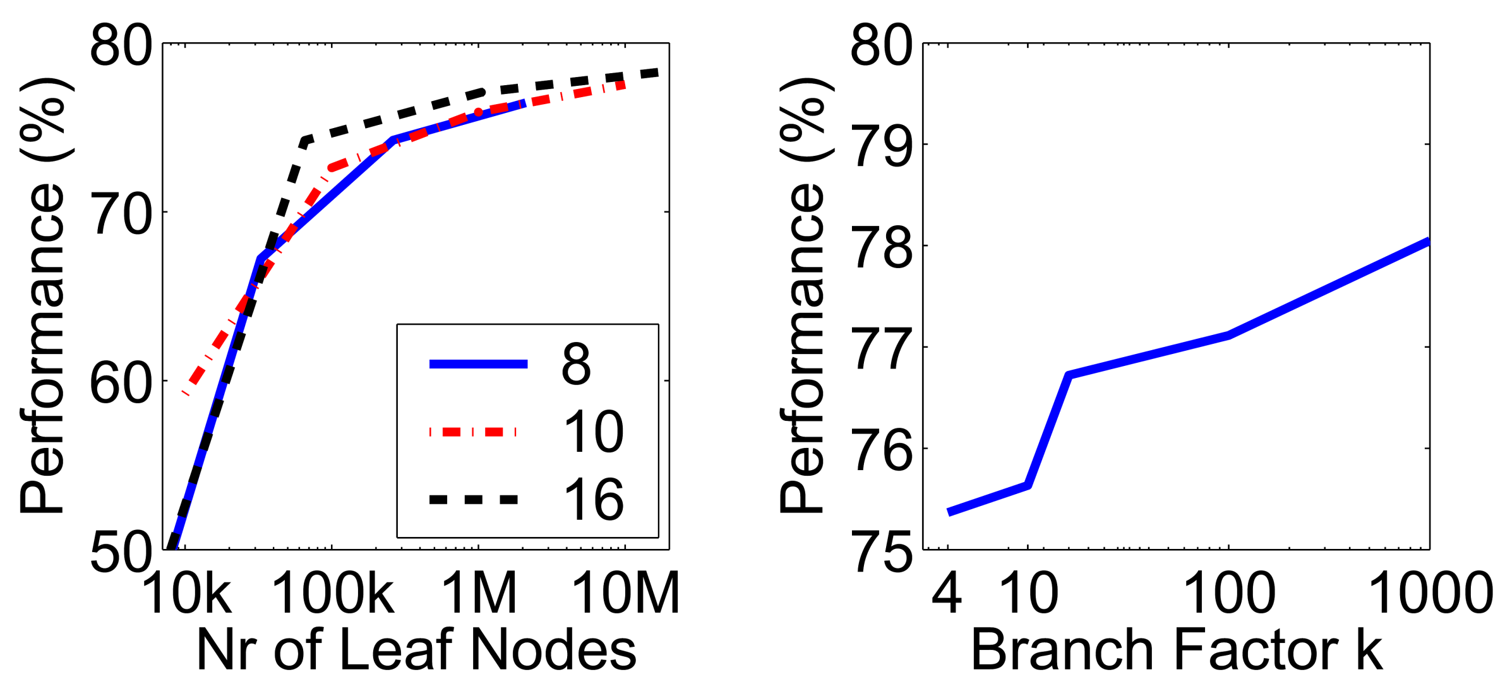
Higher branch factor works better (but slower)
Notes:
We also find that performance improves with the branch factor.
This improvement is not dramatic, but it is interesting to note that very low branch factors are somewhat weak, and a branch factor of two results in partitioning the space with planes.

Slide 52
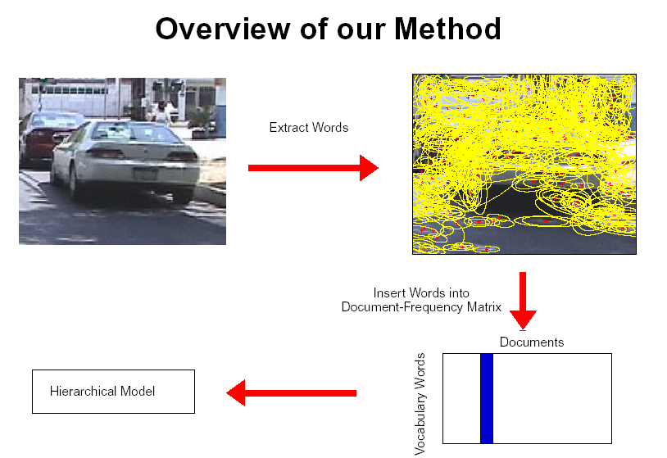
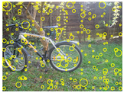
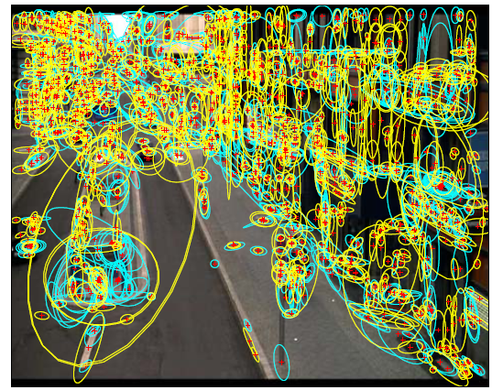
Sampling strategies
Sparse, at interest points
Dense, uniformly
Randomly
To find specific, textured objects, sparse sampling from interest points often more reliable.
Multiple complementary interest operators offer more image coverage.
For object categorization, dense sampling offers better coverage.
[See Nowak, Jurie & Triggs, ECCV 2006]
Multiple interest operators
Image credits: F-F. Li, E. Nowak, J. Sivic

Slide 53
Can we be more accurate?
So far, we treat each image as containing a “bag of words”, with no spatial information
Which matches better?
e
h
a
f
e
e
z
a
f
e
h
a
f
e
e

Slide 54
Can we be more accurate?
So far, we treat each image as containing a “bag of words”, with no spatial information
Real objects have consistent geometry

Slide 55
Final key idea: geometric verification
Goal: Given a set of possible keypoint matches, figure out which ones are geometrically consistent
How can we do this?

Slide 56
Final key idea: geometric verification
RANSAC for affine transform
Repeat N times:
e
z
e
z
a
a
Randomly choose 3 matching pairs
f
f
e
e
Estimate transformation
Affine Transform
e
z
e
Predict remaining points and count “inliers”
z
a
a
f
f
e
e

Slide 57
Application: Large-Scale Retrieval
Query
Results on 5K (demo available for 100K)
[Philbin CVPR’07]

Slide 58
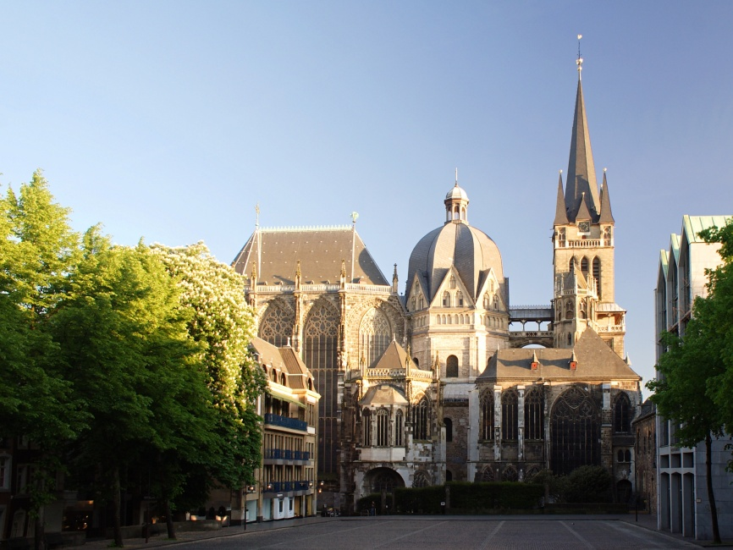
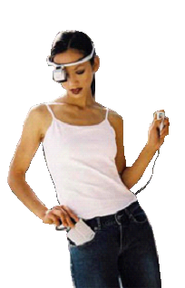
Example Applications
Aachen Cathedral
Mobile tourist guide
Self-localization
Object/building recognition
Photo/video augmentation
[Quack, Leibe, Van Gool, CIVR’08]

Slide 59
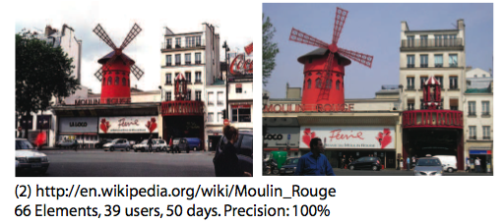
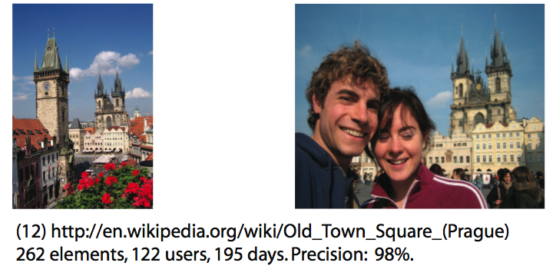
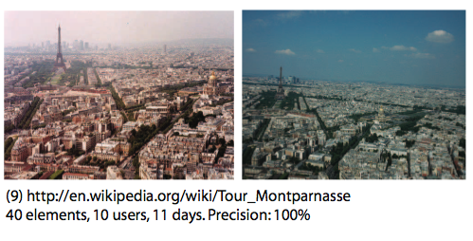
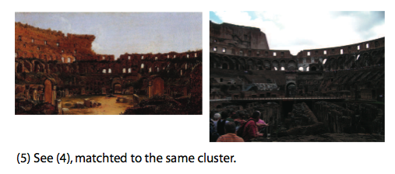
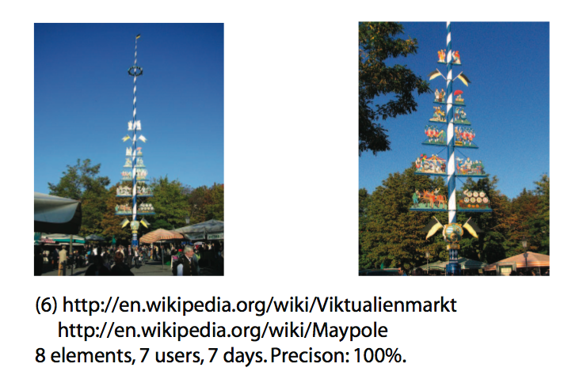
Application: Image Auto-Annotation
Moulin Rouge
Old Town Square (Prague)
Tour Montparnasse
Colosseum
Viktualienmarkt Maypole
Left: Wikipedia image Right: closest match from Flickr
[Quack CIVR’08]

Slide 60
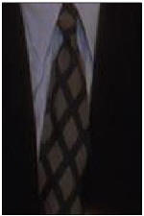













Video Google System
Query region
Collect all words within query region
Inverted file index to find relevant frames
Compare word counts
Spatial verification
Sivic & Zisserman, ICCV 2003
Demo online at : http://www.robots.ox.ac.uk/~vgg/research/vgoogle/index.html
Retrieved frames

Slide 61





Things to remember
Object instance recognition
Find keypoints, compute descriptors
Match descriptors
Vote for / fit affine parameters
Return object if # inliers > T
Keys to efficiency
Visual words
Used for many applications
Inverse document file
Used for web-scale search

